Slide 1
What does an artificial neuron do?
Understanding activation functions
Gene Olafsen

Slide 2
Questions:
Why are there so many activation functions?
Does one activation function work better than another?
What is the process of selecting an activation function?

Slide 3
What does an artificial neuron do?
An artificial neuron calculates a “weighted sum” of its input, adds a bias and then decides whether to “fire” or not.
Let's look at the mathematical function...
*Actually, it is the activation function inside the neuron that decides to fire or not.

Slide 4

Math at the heart of a neuron
The value of Y can be anything ranging from -infinity to +infinity.
Something must decide whether to fire the neuron, without knowing the bounds of Y.

Slide 5
Activation function wraps the basic neuron
The activation function checks the Y value produced by a neuron and decides if it exceeds a threshold such that outside connections should consider this neuron as fired or not-fired.
ACTIVATION FUNCTION

Slide 6
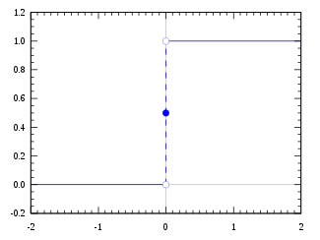
step function
If the value of Y is above a certain threshold value, declare the neuron "fired".
If Y is less than the threshold, then the neuron is not "fired".

Slide 7
Binary Classifier
If you are creating a binary classifier, a Step function seems to be a good fit. The neuron fires or doesn't fire depending on the threshold.
But what if you want to employ more than one neuron to help classify many types?
In situations where there are multiple neurons 'firing' it is advisable to have their activation not just output a 'fired' or 'not-fired' state, but activate say "25%".

Slide 8
Layers of Neurons
Additional neurons...
Linear activation propagated
Input
Neuron
Hidden
Neuron
Output
Neuron

Slide 9
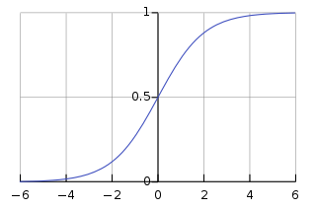

Sigmoid function
A sigmoid function is a mathematical function having a characteristic "S"-shaped curve or sigmoid curve.
Sigmoid functions are one of the most widely used activation functions

Slide 10
Sigmoid advantage
Smooth 'step-like' shape.
It is non-linear and has a smooth gradient.
Any small changes in the values of X in the region between –2 and 2 will cause values of Y to change significantly; and it tends to bring the activations to either side of the curve.
The output of the activation function is always going to be in range (0,1), which means it is range-bound and won't "blow up" activations.

Slide 11
Vanishing gradients
Take note, towards either end of the sigmoid function, the Y values tend to respond less and less to changes in X.
This means that the gradient at that region is going to be small toward either end of the function—giving rise to what is known as "vanishing gradients".
When the gradient is small and cannot make a significant change it is said to have "vanished". The outcome is the network refuses to learn further or is drastically slow in any progress it makes.

Slide 12
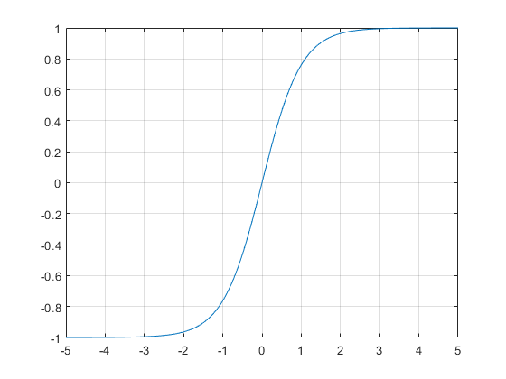
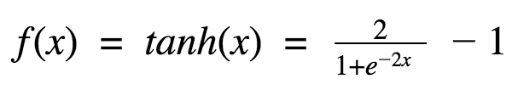
Tanh function
The tanh function, a.k.a. hyperbolic tangent function, is a rescaling of the logistic sigmoid, such that its outputs range from -1 to 1. (There’s horizontal stretching as well.)

Slide 13
Hyperbolic tangent
The tanh function has characteristics similar to sigmoid function.
The gradient is stronger for tanh than sigmoid ( derivatives are steeper)
The output of the activation function is always going to be in range (-1,1), which means it is range-bound and won't "blow up" activations.
Deciding between the sigmoid or tanh will depend on your requirement of gradient strength.
Like sigmoid, tanh also has the vanishing gradient problem.

Slide 14
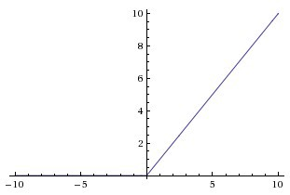

Relu : rectified linear unit
First introduced by Hahnloser et al. In a paper in Nature in 2000 it is backed by strong biological motivations and mathematical justifications
ReLU was demonstrated for the first time in 2011 to enable better training of deeper networks and compared to the widely used activation functions prior to 2011.
ReLU is also known as a ramp function and is analogous to half-wave rectification in electrical engineering.

Slide 15
Advantage: Relu
The ReLU gives an output x if x is positive and 0 otherwise.
This gets us closer to what biology seems to be doing when deciding whether or not inputs should pass through the neuron and throughout the rest of the network.
Nonlinear and combinations of ReLU are nonlinear- which means it can be used in stacked layers!
Less computationally expensive than tanh and sigmoid because it involves simpler mathematical operations.

Slide 16
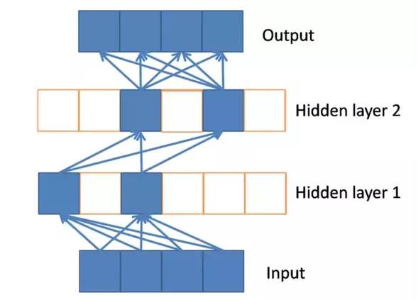
Something called... sparse activation
Notice the nonactivated neurons in the hidden layers using ReLU activation. This wouldn’t happen with something like the hyperbolic tangent activation function because too many non-zeros would creep past the neurons.

Slide 17

Sparse activation and the brain
Studies conducted on ‘brain energy expenditure’ suggest that biological neurons encode information in a ‘sparse and distributed way.’ This means that the percentage of neurons that are active at the same time are very low: in the range of 1–4%.

Slide 18
Disadvantage: Relu
ReLU is NOT bound.
It's output can range from 0-infinity, which means it can "blow up" activations.
The horizontal line in ReLU for –X values means that the gradient can go towards 0.
This is called "dying ReLu problem". Which can cause neurons to just die and not respond making a substantial part of the network passive.

Slide 19
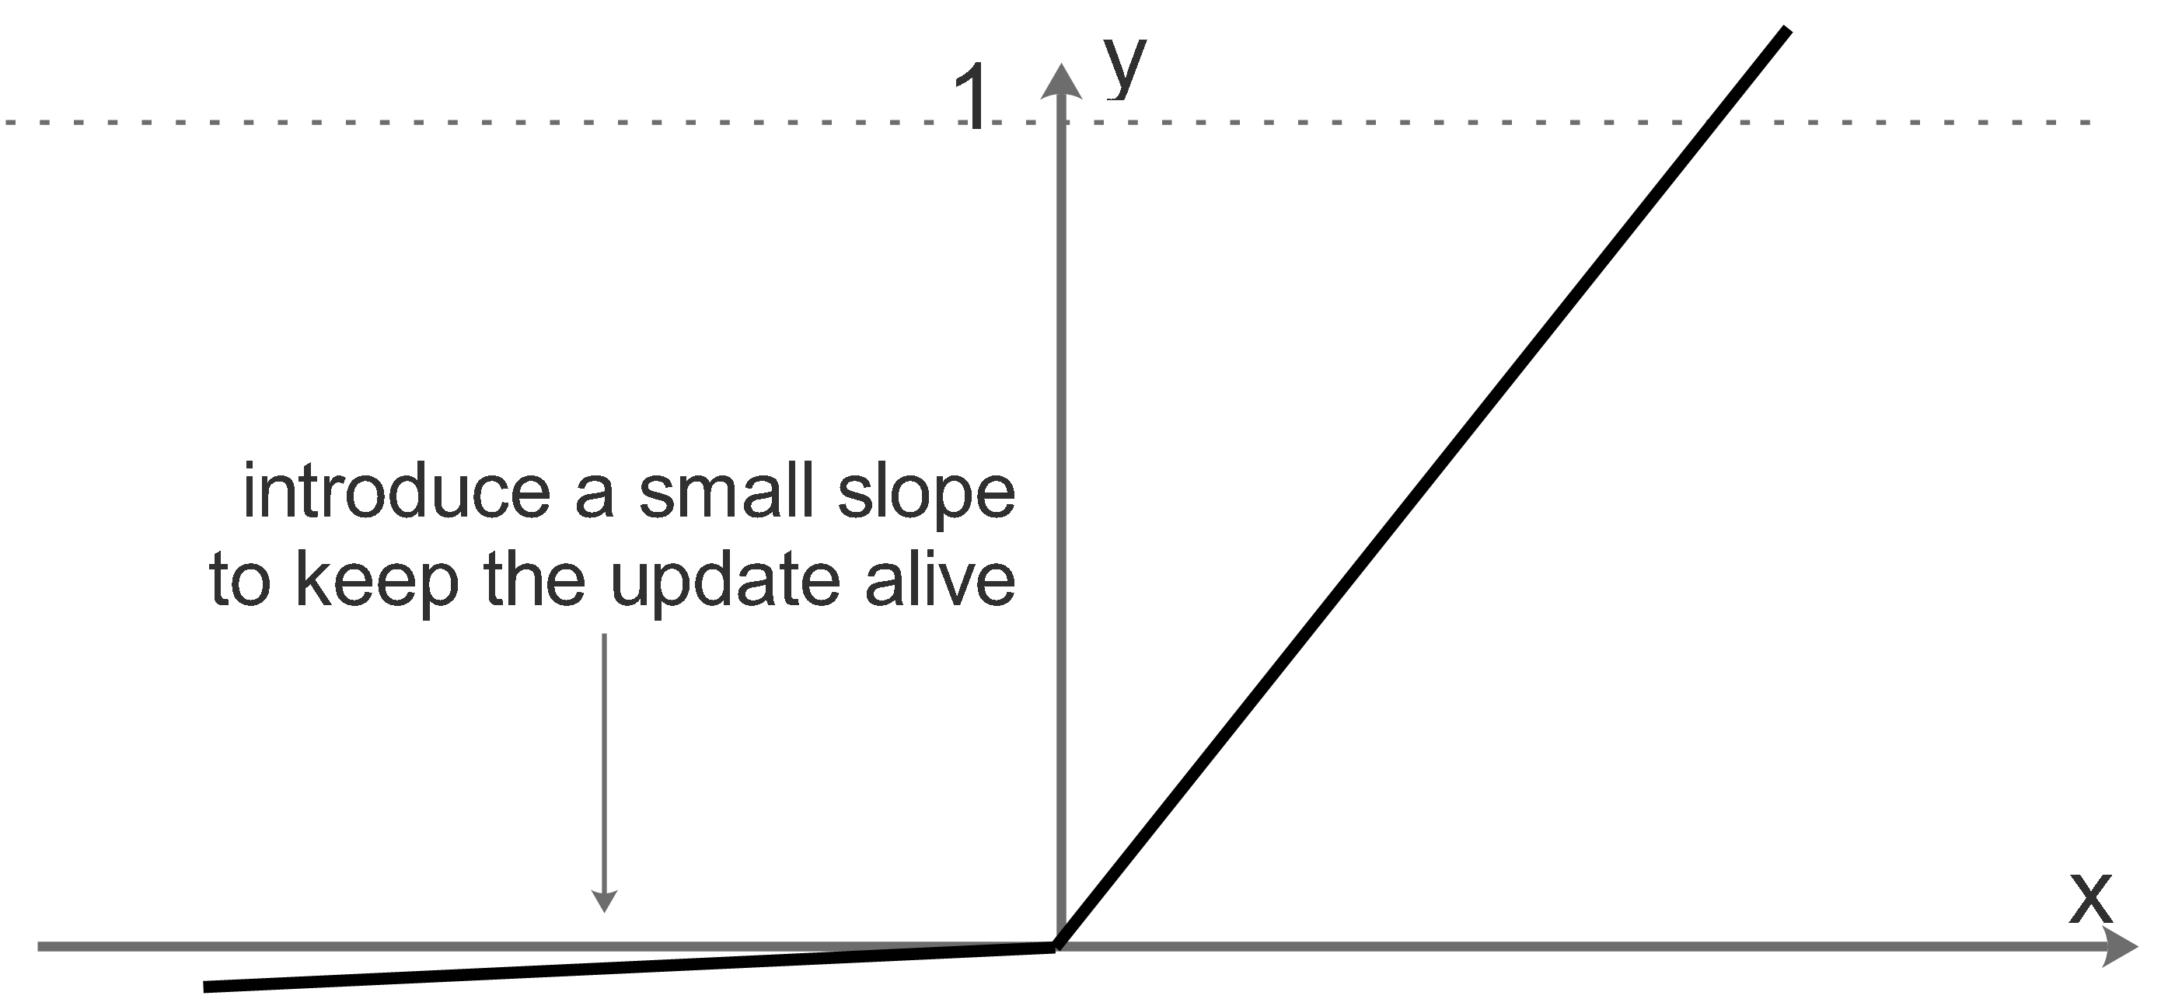
Leaky ReLU
Leaky ReLU is a variation of ReLU mitigate the "dying ReLU" issue by simply making the horizontal line into non-horizontal component.
For example:
y = 0.01x for x<0 will make it a slightly inclined line rather than horizontal line.

